Slide 1
Resource (Re)allocation and Admission Control for Adaptive Multimedia Services
Krunoslav Ivesic
University of Zagreb, Faculty of Electrical Engineering and Computing
Unska 3, Zagreb, Croatia
krunoslav.ivesic@fer.hr

Slide 2
Outline
Problem description
Media degradation path
Resource allocation
Admission control
Conclusions and future work

Slide 3
Problem description
Multimedia services
Two or more media components
Complex Quality of Service (QoS) management due to service dynamics
Potentially very high resource consumption
Goal: to provide description for such services, analyze service dynamics and create appropriate mechanisms for admission control and resource (re)allocation
Notes:
*) Complex QoS management: design of “elastic” services and “smarter” resource (re)allocation

Slide 4
Service description
For services with several flows, users’ preferences regarding flow importance:
May vary
Should be considered at session initiation time
Appropriate service description: Media Degradation Path (MDP)
A list of service configurations
Each configuration consists of operating parameters, resource requirements and utility value (a numerical indicator of user’s satisfaction)
Notes:
By introducing MDP...

Slide 5
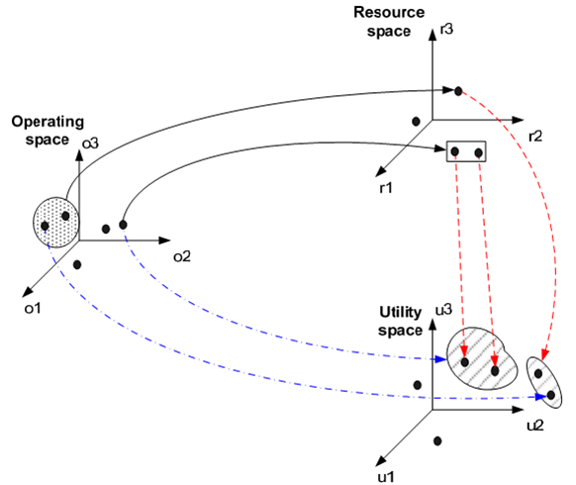
Media degradation path: origin
Mapping between adaptation, resource and utility spaces
L. Skorin-Kapov and M. Matijasevic, “A data specification model for multimedia QoS negotiation,” in MobiMedia ’07: Proc. of the 3rd Int. Conf. on Mobile Multimedia communications, (Nafpaktos, Greece), pp. 1–7, ICST, 2007.
Notes:
... The three spaces are defined for each media component. The points in O are mapped to points in R and U. The goal is to select those mappings from O that maximize the utility. The selection of optimal points for all flows => optimal configuration. Optimal conf. & several next-to-optimal ones => MDP. Since the MDP contains the knowledge about the service... => acceptable degradation, better that unpredictable one!
*) States: service dynamics

Slide 6
Media degradation path - scheme
Notes:
Knowledge about the service

Slide 7
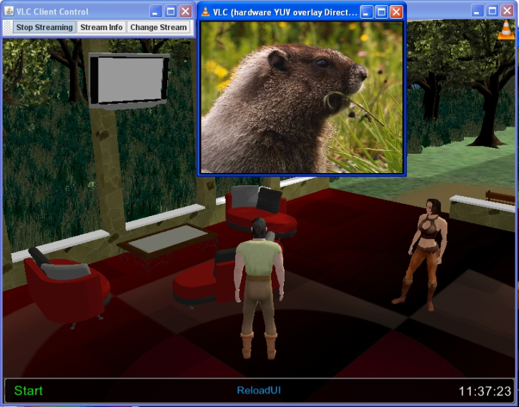
MDP – Service states
An example scenario of a service with three states

Slide 8
Resource reallocation
In case of significant decrease in resource availability:
Switch active sessions to less resource demanding configurations from current states of their MDPs
Maximize the total utility, while considering priorities of users and services, subject to resource demands
Mathematical formulation: multi‑choice multidimensional 0-1 knapsack problem (MMKP), NP‑complete

Slide 9
Resource reallocation: mathematical formulation (1)
Number of currently active sessions: n
Number of configurations in MDP of session u: p_{u}
Flows of configuration ui: 1,..., h_{ui}, h_{ui} + 1,..., z_{ui}
Bandwidth requirements for configuration ui:
b_{ui} = (b_{ui1}, ..., b_{uizui}), where b_{uij} = (b_{uij1}, ..., b_{uij9})
Configuration’s utility, revenue and cost: U_{ui}(b_{ui}), R_{ui}(b_{ui}), C_{ui}(b_{ui}). Normalization:
Weight factor:
Notes:
1,..., hui downlink; the others uplink.

Slide 10
Resource reallocation: mathematical formulation (2)
Users’ utility:
Operator’s utility:
The goal is to maximize the total utility
such that bandwidth constraints are fulfilled.
Notes:
xui – binary variables that define if some configuartion is selected or not.

Slide 11
Resource reallocation: mathematical formulation (3)
The bandwidth constraints:

Slide 12
Implementation in Mathematica
Random generation of sessions in Wolfram Mathematica 7.0
Optimal configuration and several suboptimal configurations with decreasing bandwidth requirements and some flows dropped
Utility, revenue and cost as functions of requirements, normalized to enable fair comparison
Gradual decrease of the bandwidth to 90%, 80%, ..., 40% of max. requirements

Slide 13
GUI in Mathematica

Slide 14
Admission control (1)
In case of decreased resource availability new sessions can be admitted with lower quality configurations from their MDPs, rather then being entirely rejected

Slide 15
Admission control (2)
Handling state changes
If session changes its state, the configuration to be activated in the new state is:
The optimal one, if the session has been admitted with the optimal configuration from the first active state
One of the suboptimal configurations, if the session has been admitted with one of the alternative configurations from the first active state

Slide 16
Admission control and resource reallocation together?
Is degradation of existing sessions justifiable?
Suggestion:
Reserve a portion of resources for handoff and state changes
Degrade only those sessions that have increased their resource consumption considerably since their admission (due to state changes)

Slide 17
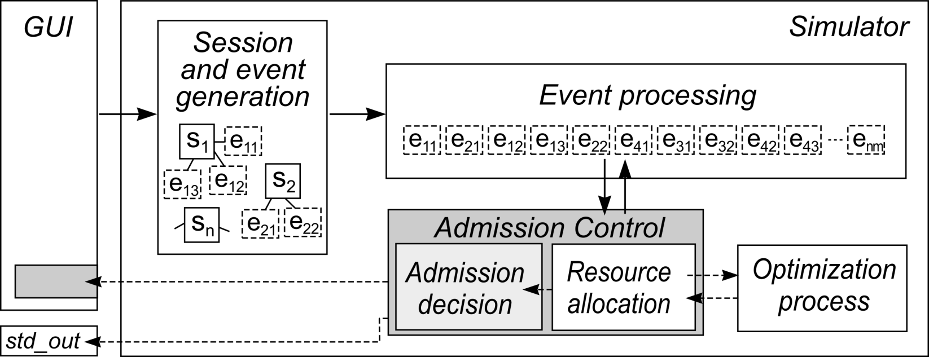
Putting it all together: simulation
A simulator tool named ADAPTISE (ADmission control and resource Allocation for adaPtive mulTImedia SErvices)
Simulates multimedia session arrivals, durations, resource allocation and state changes

Slide 18
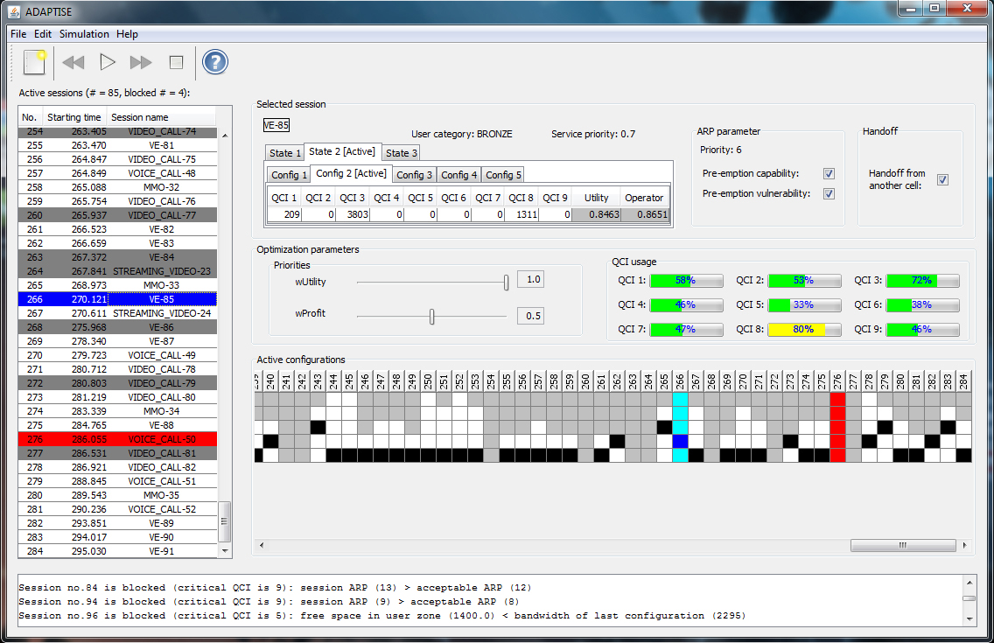
ADAPTISE GUI

Slide 19
Tests of resource reallocation
Simulation of sessions in ADAPTISE, 5 simulation instances for 2 cases (each 1 h long):
Each QCI set to 100 kbps
Each QCI set to 90 kbps
Goal: to count the number of occurences of the optimization process

Slide 20
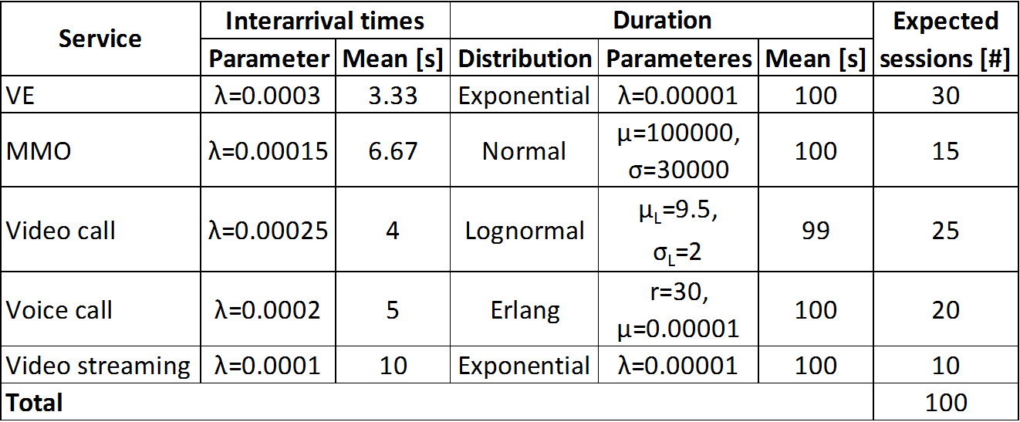
Tests of resource reallocation (2)
Parameters of the services

Slide 21
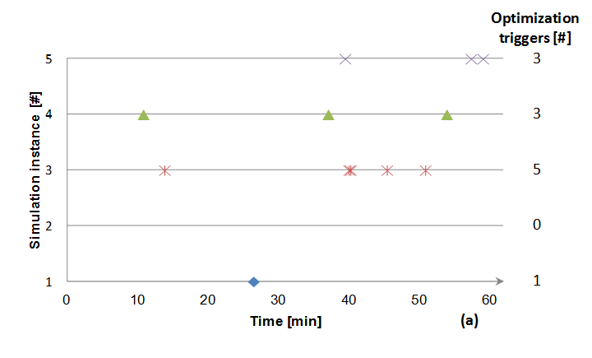
Optimization occurencies
QCIs set to 100 kbps

Slide 22
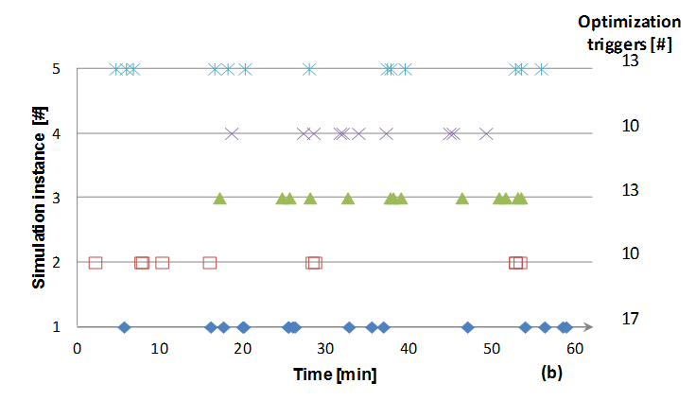
Optimization occurencies (2)
QCIs set to 90 kbps

Slide 23
Statistics
A minor portion of the total number of sessions degraded, i. e., (a) 1.81% and (b) 4.72%.

Slide 24
Applicability in real network?
LTE-Sim
Simulator of the LTE network, developed by G. Piro et al. from Politecnico di Bari, Bari, Italy, released under GPLv3 license
Simulates LTE downlink and uplink
Considers both the E-UTRAN and the EPS, multicell simulation, user mobility, handover, radio resource optimization, frequency reuse, adaptive modulation and conding
Several traffic generators at the application layer
VoIP, infinite buffer, trace based, constant bit rate
No full PHY simulation, analytical model used
Only UDP and unacknowledged mode supported

Slide 25
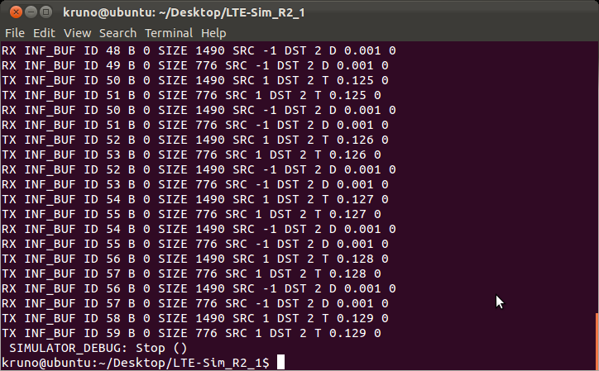
LTE-Sim
Example output trace

Slide 26
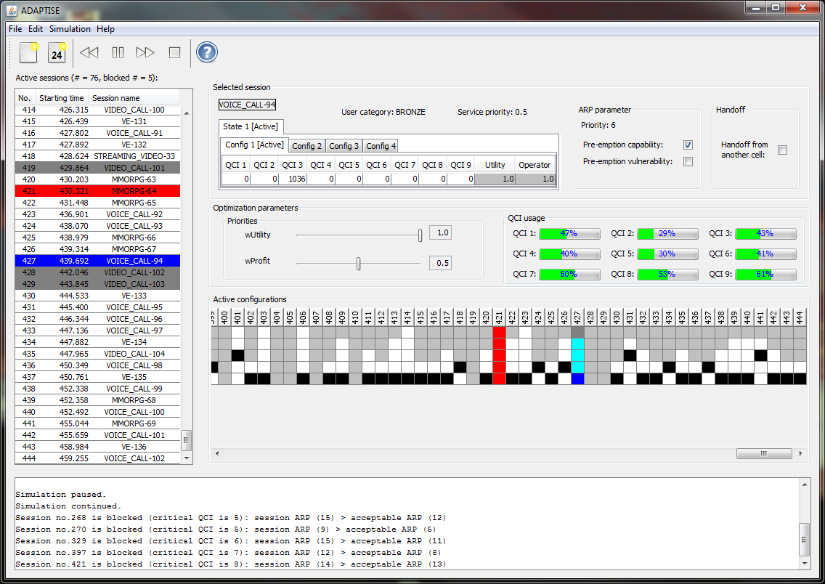
ADAPTISE + LTE-Sim
The idea: export the ADAPTISE simulation as trace and import it to the LTE-Sim

Slide 27
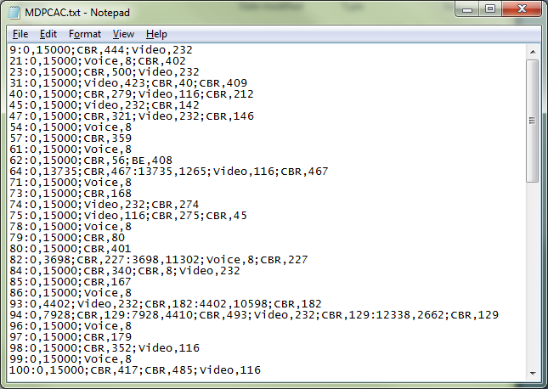
Example ADAPTISE trace

Slide 28
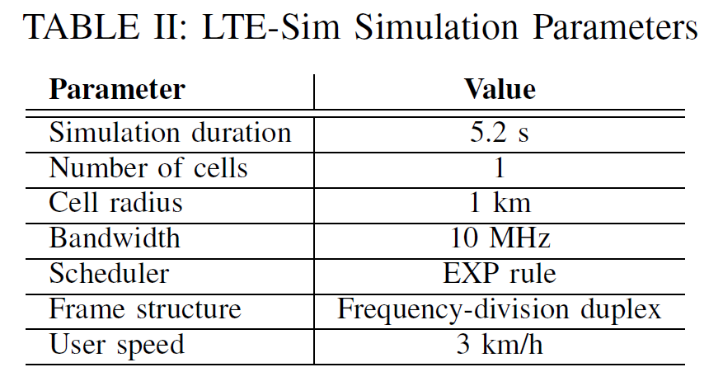
Admission control in LTE-Sim
5 simulation instances in ADAPTISE, each run once with admission control based on the MDP and once without it
For each of these 10 instances, simulation has been rerun in LTE-Sim 15 times

Slide 29
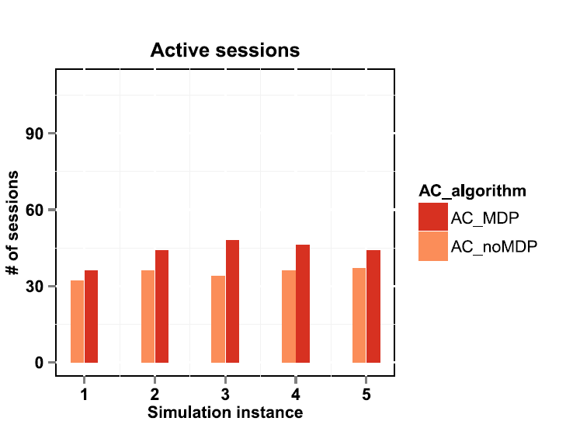
Results (1)
Number of sessions

Slide 30
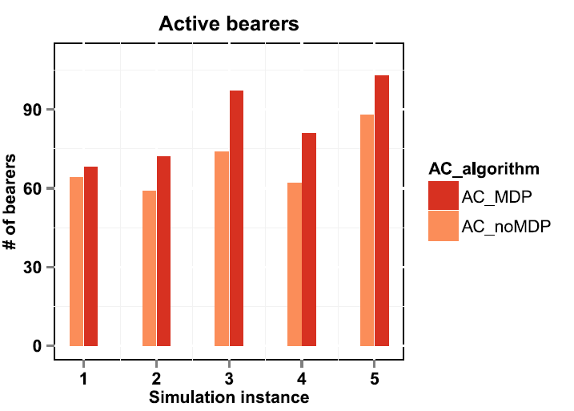
Results (2)
Number of bearers

Slide 31
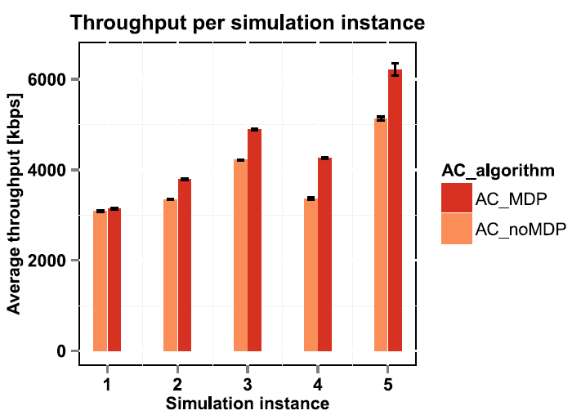
Results (3)
Total throughput

Slide 32
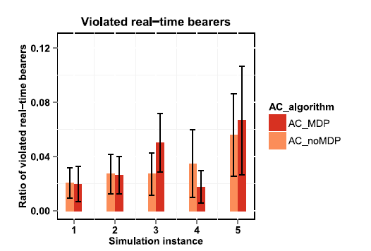
Results (4)
Violation of loss for real-time bearers

Slide 33
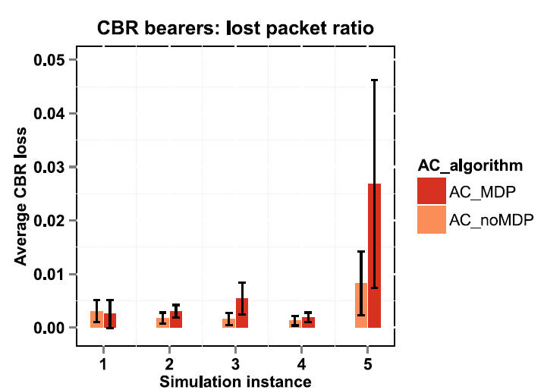
Results (5)
Loss of non real-time bearers

Slide 34
Conclusions
MDP is a suitable descriptor for adaptive multimedia services
Improves admission probability since it enables admission with a suboptimal configuration
Proved by simulations in ADAPTISE and LTE-Sim
Resource reallocation based on the MDP improves resource management for dynamic multimedia sessions with variable flow number
Current/future work

