Slide 1
MMORPG Player Behavior Model based on Player Action Categories
Mirko Suznjevic, Ivana Stupar, Maja Matijasevic
University of Zagreb, Faculty of Electrical Engineering and Computing
Unska 3, Zagreb, Croatia
mirko.suznjevic@fer.hr
Notes:
Hello everybody, thanks Shen for a good presentation, always wanted to play a good MMORTS maybe this architecture will enable some. I am going to talk about different type of MMOs - MMORPGs.
I am sure that everybody here know what MMORPGs are. Games like World of Warcraft, Age of Conan, EverQuest and so on. Most of you know have probably played some mmorpg. So, you know that after a long day of working/studing a true MMORPG player wants one thing!

Slide 2
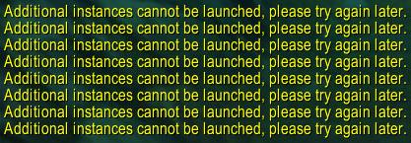
Notes:
To slay some Dragons. Or undead, or demons, or some other corrupted and evil thing like players of the opposing faction.
But, sometimes unfortunate tings like this happens! (Animation).
This message means there are NO DRAGONS for you. And why do we get this message? Because the game provider did not adapt well to player behavior or anticipated the changes in it well.

Slide 3
Problem
How does player behavior affect load (both network and server)?
We study and model player behavior
Session length
Number of player on a server
Session composition (what exactly players do during a session)
Model implementation in Player behavior simulator (Java)
Results enable:
Better infrastructure planning and optimization
Churn analysis
Input for other tools
Notes:
The main problem is how does player behavior affect load both network and server. Our research group is more focused on the network, so our focus is more to the network.
We try to solve this problem by modeling player behavior in terms of session length, number of players and session composition. Session composition in terms of what EXACTLY are players doing during a session. This is our main difference in regard to other studies of player behavior.
We implemented our model in Player Behavior Simulator, a tool developed in java.
In the end why we think this research is important. First for better infrastructure planning and optimization, for both network links (which are ATM hugely over provisioned – Blizzard stated that their WoW network capacity is never filled up to 1/5, as ell as to server processing power. Also understanding payer behavior can lead to better optimization and adjustments to player behavior. The no more instances can be launched error was caused by not realizing at which extent will changes in the game (introducition of dungeon finder) will affect player behavior. And that is by Blizzard, a strongest MMO company.
Player behavior model can be useful for churn estimation. Results of our simulator can be used as an input for other tools. We intend to use it for our traffic generator aware of player behavior, but it can be used for example for virtual item theft detection, or previously mentioned load balancing optimization algorithms.
As I said the core problem is understanding player behavior and its effect on the load of a MMORPG system.

Slide 4
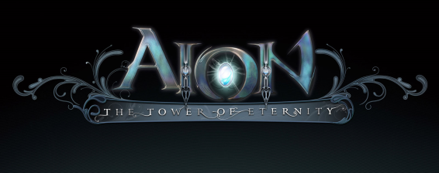
Introduction
Massively Multiplayer Online Role-Paying Game (MMORPG)
Players assume the role of a character (in a persistent virtual world) and take control over many of that character's actions
Numbers constantly increasing
460 MMORPGs active / in development (mmorpg.com)
54 million MMO players in USA alone (NewZoo)
Business models
Subscription based
Selling content updates
Selling virtual items (micro transactions)
Notes:
Now just to review the basics, MMORPG stands for …. In this genre of games players assume the role of a character in persistent virtual world and control its actions.
The main characteristic of interest in case of MMORPG is their current high popularity in the market, and constant revenues they provide to their developers/publishers.
Everybody wants the piece of this market and we have curently 460 MMORPGs active.
According to the report from newzoo there is 54 million of MMO players in USA.
As for the business models we currently have 3 subscription based or paying monthly fee to play, selling content updates (Guild Wars) where each new update is paid for. In business models there is currently a shift towards providing a free game while revenue is formed from selling virtual items or micro transactions, a model which is gaining popularity. Even subscription based MMOs incorpot some sort of microtransactions. As Blizzard a publisher of WoW earned a $2 Million In 4 Hours. Shift in this buissness model where no payment is needed to enter the game also has significant effect on the increase of players numbers, game needs a lot of players as only a portion of them will actually pay something. With that importance of studding player behavior, as even small games can be open to a large number of players, and need to be designed with player behavior in mind.

Slide 5
Introduction – Player behavior
Session lengths – OK
Number of players – OK
Session composition - ?
How to measure what exactly players do in MMORPG?
Many possible (inter)actions
Vast virtual worlds
Classification (grouping) of possible situations in virtual world
Needs to be generally applicable
Take into account both player input and surroundings
Meaningful in relation to game design
Notes:
As I said we look at player behavior in terms of session length, player number which are easily measured and comprehended.
But how to measure session composition which describes what exactly are players doing in the virtual world. There is a high number of possible actions and interactions and virtual worlds of MMORPGs tend to be vast (hundreds of square km).
We approached the problem through classification of possible situations in the virtual world. During this classification we took into account the general applicability in terms that this categorization needs to be aplicable to majority of MMORPGs. Also categorization needs to take into account both player surroundings and their interactions, and player input and interaction with surroundings. Lastly it needs to be meaningful in relation to game design.
For example if game designers are to perform a change in the game, it should be intuitively clear how it would impact each class.
This classification has been performed in our previous works, and here it will be explained briefly.

Slide 6
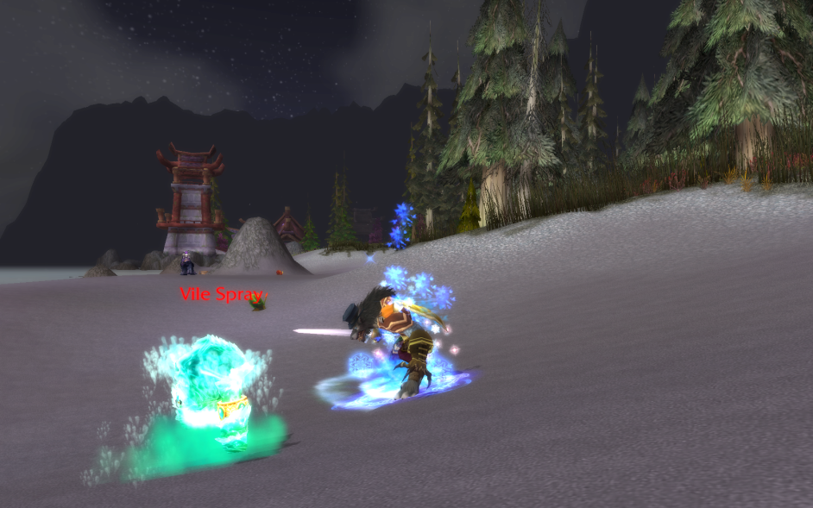
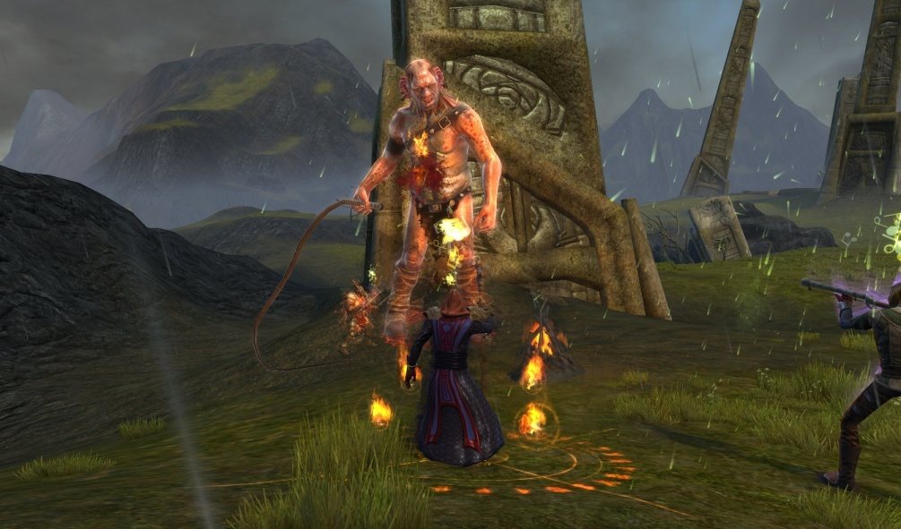
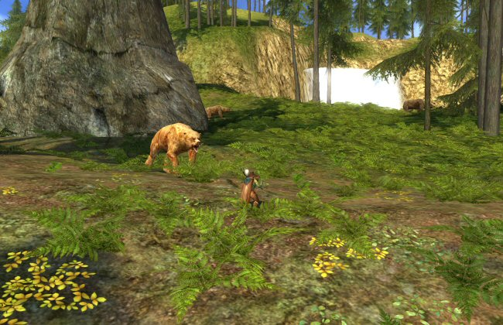
Classification - Questing
Notes:
We performed classification on 7 axis Nuber of players, number of NPCs dynamics etc. Classification is created general so it can be aplicable across MMORPGs which I will try to illustrate with screenshot from different games, which ilustrate same situations Questing is in short performing various tasks for the NPCs for some sort of reward. This is the main single player activity. It was shown that while players can do this in group they mostly do it alone (Alone together? Exploring the Social Dynamics of Massively Multiplayer Online Games). Questing score on the axis is show on the grapsh and from screenshots from RIFT and LOTRO we can see single player activity, low number of NPCs.

Slide 7
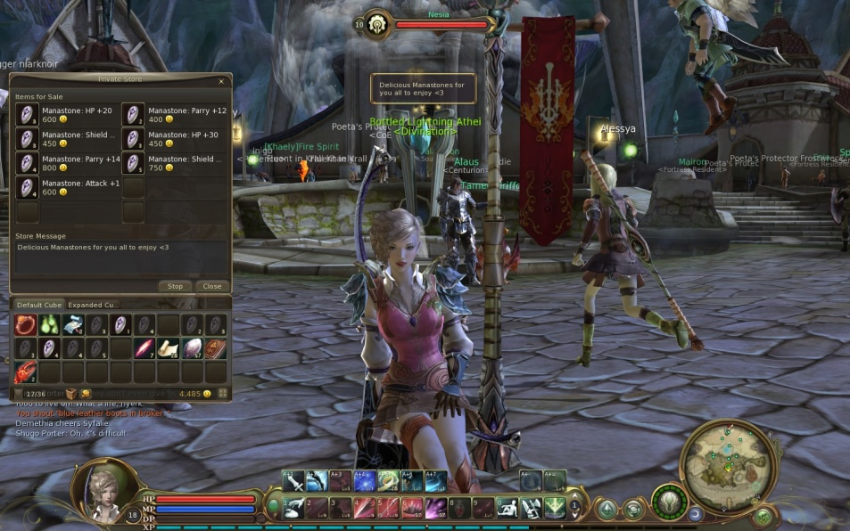
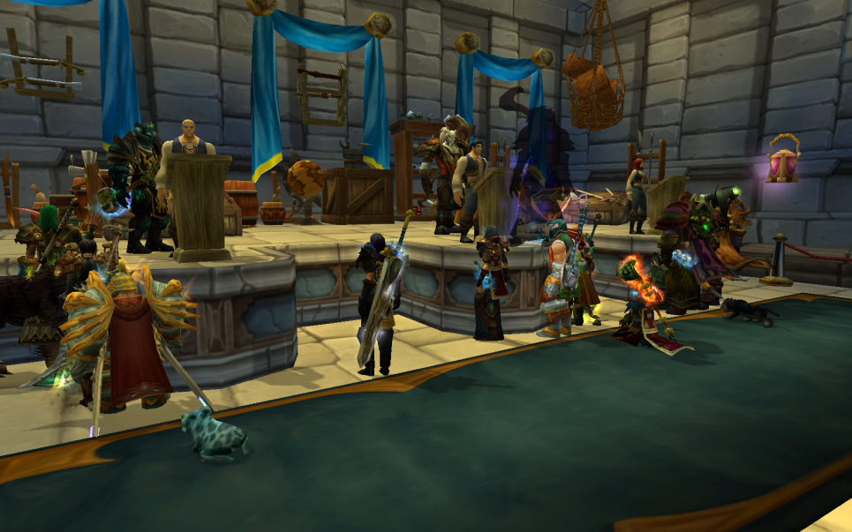
Classification - Trading
Notes:
All MMORPGs have their virtual economies and Trading incorporates economy related actions (which are non combat). As we can see from screenshots from AION and WoW there are a lot of players around but they do not interact with each other – their cooperation levels are really low.
Next category is PvP combat.

Slide 8
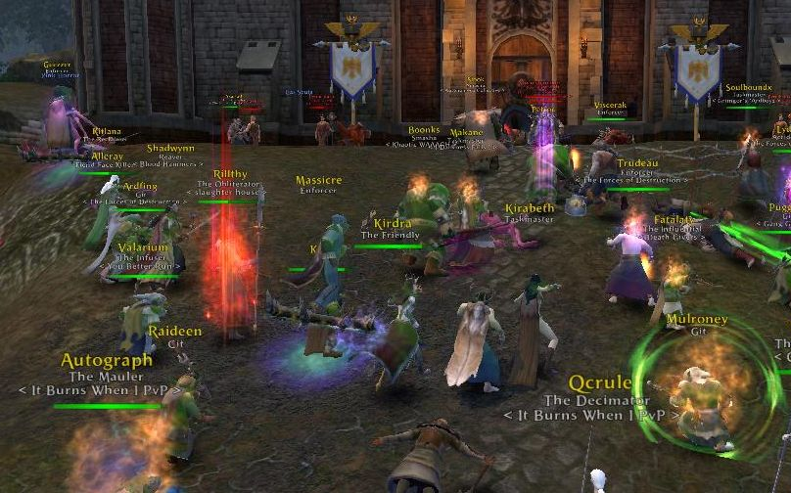
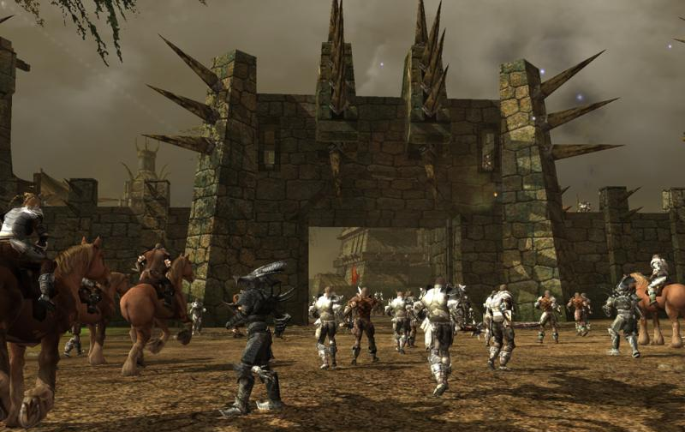
Classification - PvP combat
Notes:
As seen from these screenshots from Darkfal Online and Warhammer online, pvp combat involves a lot of players (so this is a group based action), and low number of NPCs. Requires high dynamics, mobility and interaction between players.
Now for interaction between players and pve…

Slide 9
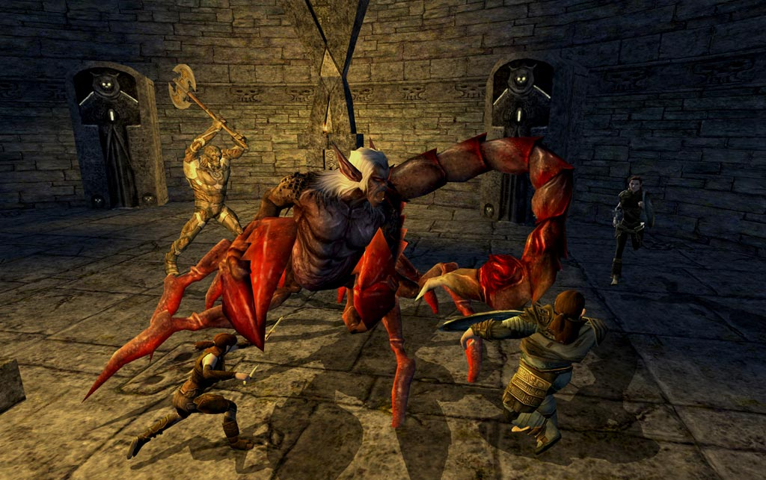
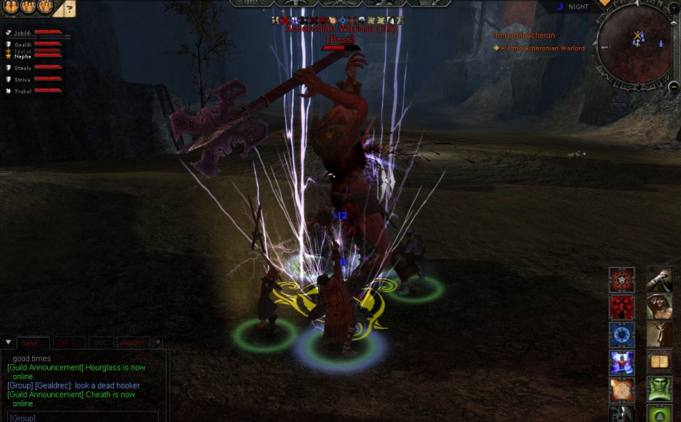
Classification - Dungeons
Notes:
We recognize small group activity – dungeons.

Slide 10
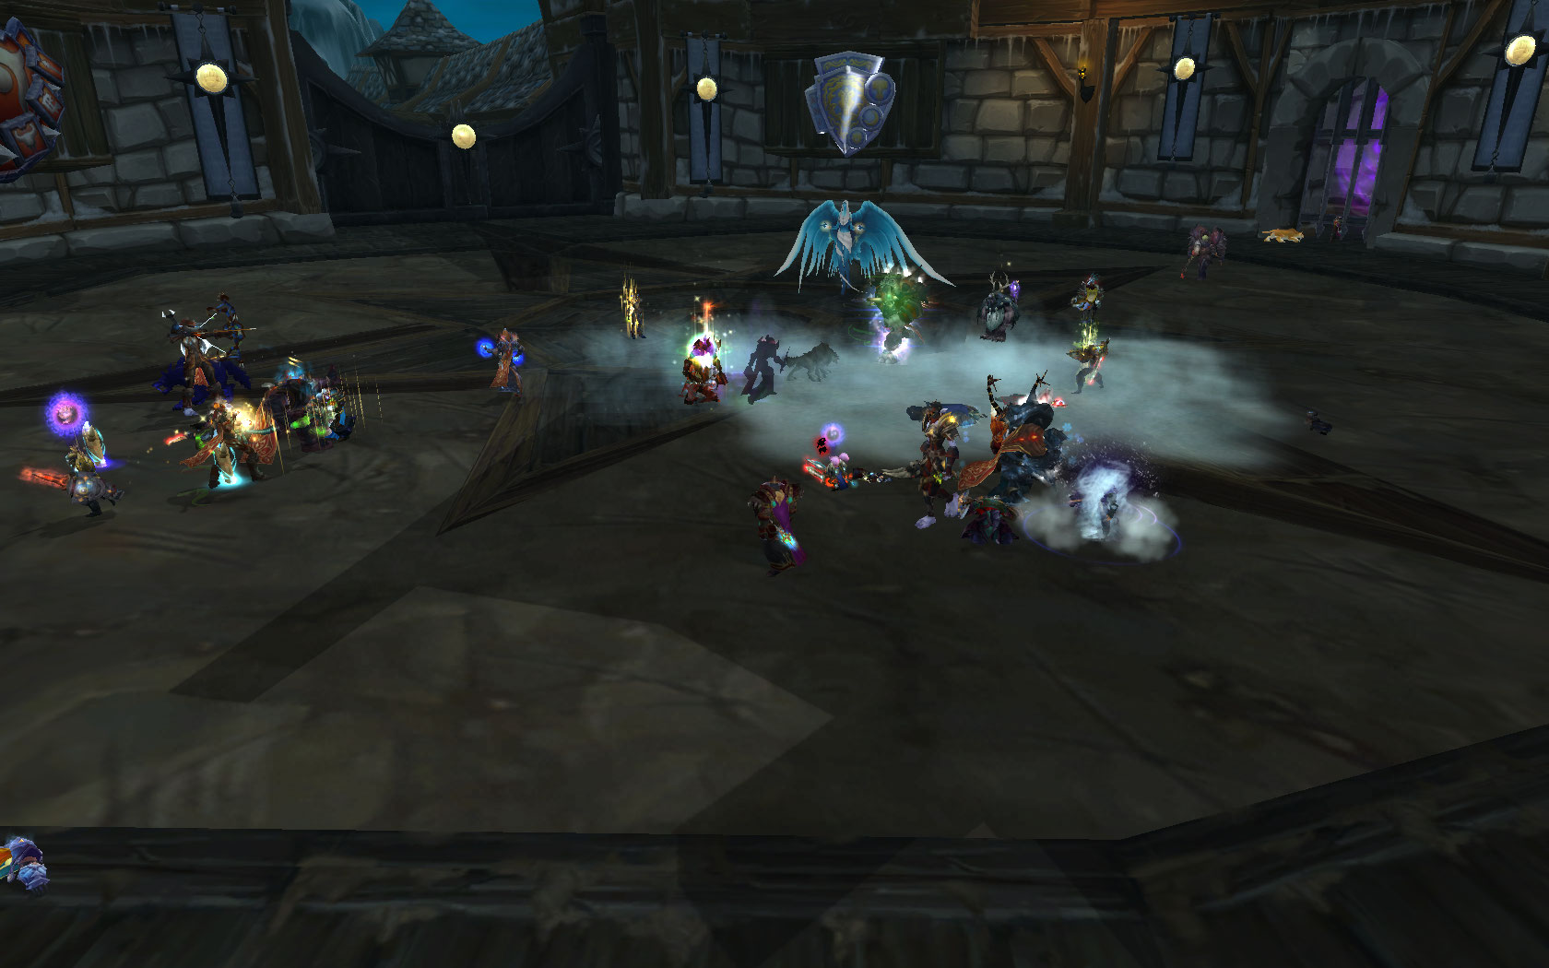
Classification - Raiding
Notes:
And large group activity – raiding. Which are very similar but differ significantly on scale. In the end, the final classification is the following..

Slide 11
Classification - Final
Notes:
As can be seen from the graph all defined categories are distinct. Now when we know what we will measure and model, lets say something about HOW we do it.

Slide 12
Use case – World of Warcraft
Notes:
As gathering players willing to participate in the research was one of the greatest issues we selected WoW for our use case, mainly because of its market share which made measurement process much easier. Regarding the process of measurements it was as follows…

Slide 13
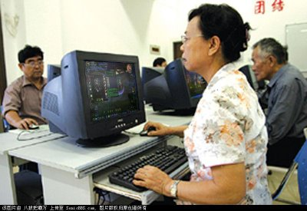
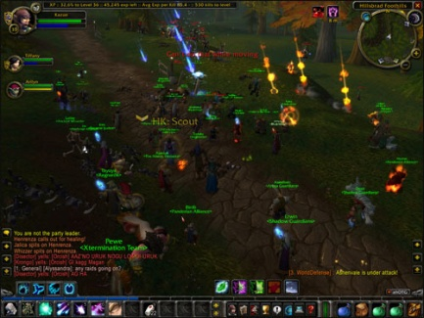
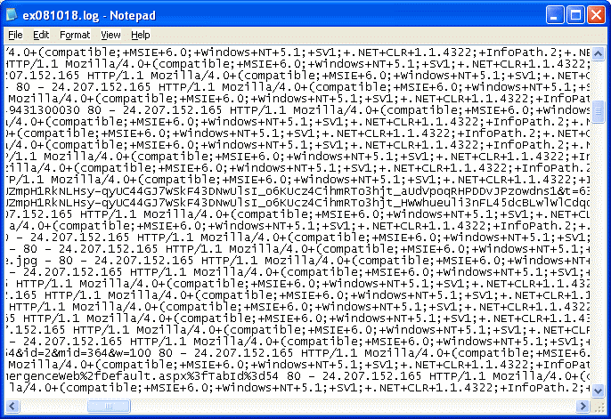
Methodology
Find players Install WSA-Logger PLAY ☺
(our WoW add-on)
Create models Process data Submit log files
Notes:
As for the methodology of the measurements we needed to find the players which volunteered to participate in the research. They installed our add-on for tracking user behavior. After the monitoring period was over they submited the log files created by the add-on. We processed that data and created the models.
We modeled session length, session composition and player number on a single shard. First I will tell more about session length.

Slide 14
Results - Session length
Problem – different results in related work
Causes:
Measurement related (sample rates, different access networks)
What is a session?
Player session
Character
session
Notes:
Session length has been thoroughly investigated in the literature, the only thing is REUSLTS differ significantly. Even for the same game – WoW.
I wanted to see why this discrepancies occur.
1st thing is obvious – measurement related differences. Some differences may arise from measuring on fixed or mobile network, and other arise from sampling methods, meaning if you sample the player base on a server each 15 minutes, you will miss many sessions which occurred in that time window.
2nd thing was that I found out that there is no firm definition of what session is! Researches in this field measure 2 different things! I illustrate the on my example ☺ I had 3 active characters in WoW, my main character which I played the longest, organized PvP rading, my 1st alternative character which I played together with my girlfriend, and an alt which I use for storing extra items.
In the end our datasets has arround 5k player sessions comprised of over 11k character sessions. So how much is the difference between reported sessions lengths based on these causes.

Slide 15
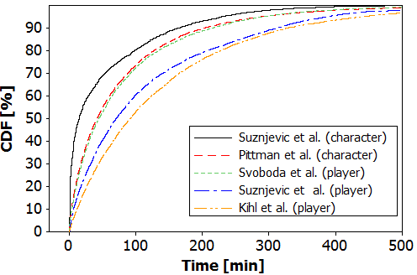
Results - Session length
Notes:
Ubaci strelice!!! Ne da mi se pokazivat ću :p
The shrortest sessions are reported in my first research which measured character sessions with highest precision (1 minute precision) but alos shorter sessions are noted.
Next we have reported values by Pittman et al. who measured character sessions with 10 minute precission. Also almost connecting with that line we have svoboda et all measurements whech are player based but are taken in a mobile network. Following are my measurements taken on players computers where we did measurements on player sessions by joining specific character sessions. And in the end longest sessions have been reported by kihl et al who performed measurements in the wired access network in Sweeden.
So we saw how session measurements differ in related work, now I want to show that session length differs depending on time of the day.

Slide 16
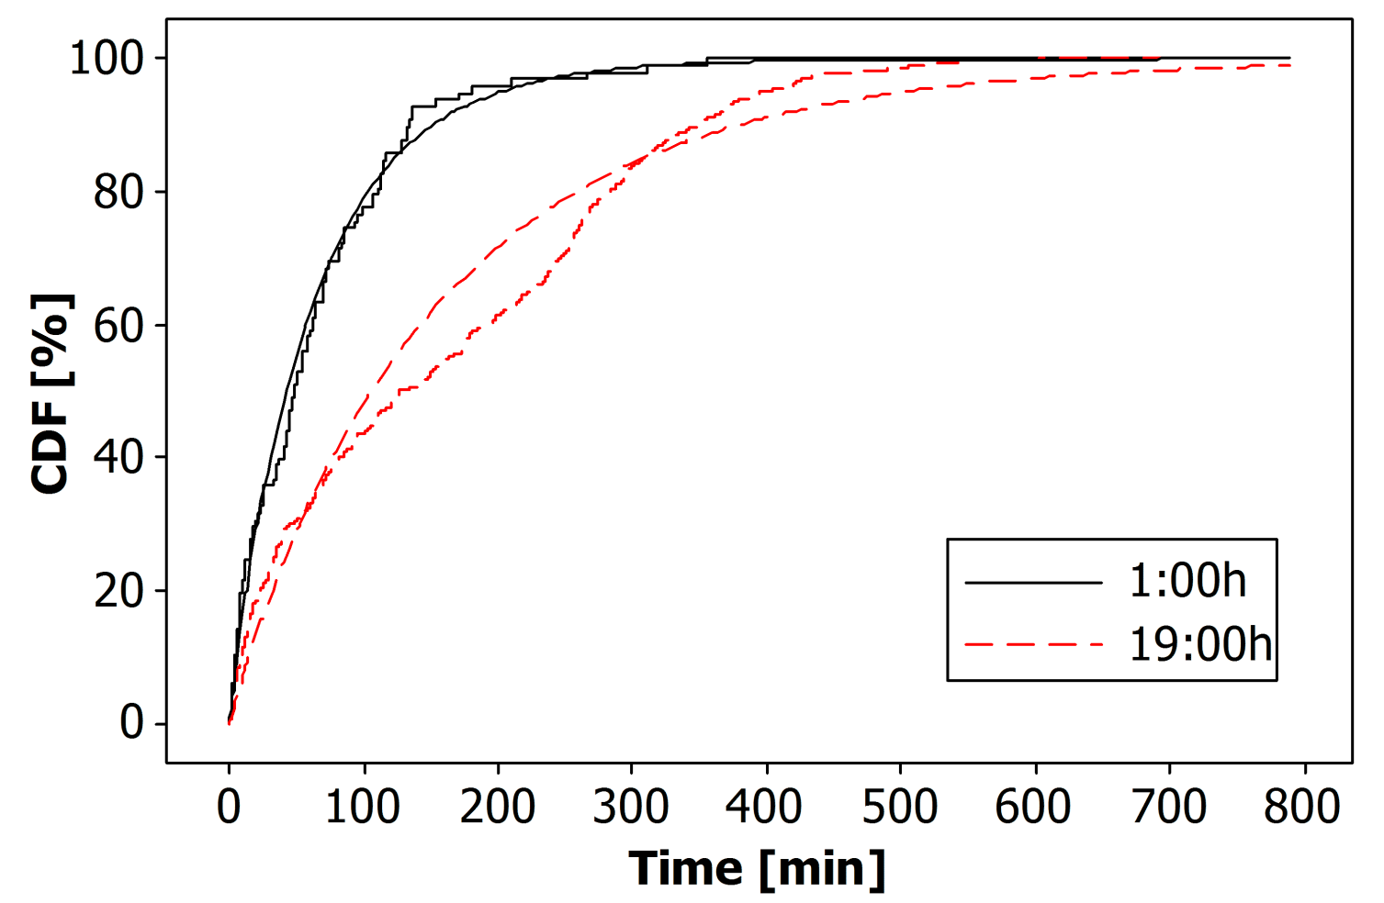
Results - Session length
Weibull distribution (confirms previous results)
Significant hourly differences
Notes:
As we can see on this CDF of sessions started in 1 hour past midnight and those started at 7 in the evning differe significantly. This is why we provide models for session lengths for each hour. Our research did confirm that Weibull distribution proved to be the best fit for session lengths.
As for the player number…

Slide 17
Results – Player number
Well covered in related work (using existing datasets)
Y.-T. Lee, K.-T. Chen, Y.-M. Cheng, and C.-L. Lei, “World of Warcraft avatar history dataset,” in Proc. of the second annual ACM conference on Multimedia systems, 2011, pp. 123–128.
D. Pittman and C. GauthierDickey, “A Measurement Study of Virtual Populations in Massively Multiplayer Online Games,” in Proc. of the 6th ACM SIGCOMM Workshop on Network and System Support for Games, 2007, pp. 25–30.
Problem: datasets contain character data, no way to extract player based data
Simulation of multiple users does not create player session lengths
Notes:
We do not do our research of the topic as we think this matter is well covered in the related work. Here are the references describing publically available datasets which we used in our modeling process.
Only problem is this datasets contain character based data! So we could not extract player arrivals and departures, only character ones.
This results in session lengths in the simulation of a server being shorter than described in the model.

Slide 18
Results – Player number
Modeled both arrival and departure processes as Homogenous Poisson Process (HPP)
Rates calculated for each hour, of each day of the week
Two categories (weekdays and weekends)
Pitman et al. dataset Lee et al. dataset
Notes:
As for our modeling process of the player number we used HPP for both arrival and departure process. We tried changing rates or the HPP for 10 minutes and 1 hour, and 1 hour did not yield much worse results. So we conclude that player number can be modeled with HPPs within 1 hour intervals as previously indicated by Chen et al. In the paper Game traffic analysis an MMORPG perspective.
As it was indicated in that paper player behavior within session can vary drastically. So lets describe that within session behavior.

Slide 19
Results – Session composition
Session segment – part of the session containing only player actions of certain type
Duration
Probability
Session segments
Questing Trading PvP Combat Questing Trading
Notes:
We define a session segment as a part of the session containing only one type of player actions and we model duration of those segments and their probability.
If we return on my previous example as I said on my main I usually did some daily quests, some trading and some organized PvP combat. After that I reloged to my 1st alt to do some quest with my girlfriend. Upon end to thos quests I would visit some auction house for selling the stuff I didn’t need , and reloged to my alt which I use to store excess goods. As we can see session segment can span multiple characters.

Slide 20
Results – Segment duration goodness of fit
Session segment duration for every hour of the day
Raiding – hour specific models
Other categories – 1 model for whole day
Underlying distribution determined through Maximum Likelihood Estimation (MiniTab)
Category | Fit
Trading | Weibull
Questing | Weibull
PvP Combat | Weibull
Dungeons | Largest Extreme Value
Raiding
Hour | Data portion | Fit
18-19 | 42% | Weibull
 | 58% | Weibull
19-20 | 44% | Weibull
 | 56% | Lognormal
20-21 | 42% | Weibull
 | 58% | Lognormal
21-22 | 100% | Weibull
22-18 | 100% | Weibull
Notes:
So when we exracted all session segments from the dataset we examined wheter there are significant differences based on the start time of the segment. All action categories besides raiding had small differences so we decided to model those categories with 1 fit for the whole day. As you can see in the table, Weibullproved to be the best fit for trading questing and pvp combat whle dungeons had the best fit with largest extreme value.
As for duration of raiding session segmets they were pretty complicated to model so we applied time division for specific hours, as well as we did a modeling with split distributions for particular hour. So we have segments started form 18 to 19 modeled with two weibull distributions, these started from 19 to 20 modeled with a combination of Weiull and Lognormal distribution.
21-22 was modeled with 1 weibull distribution as well as the remainder of the day.
So how good are the fits,

Slide 21
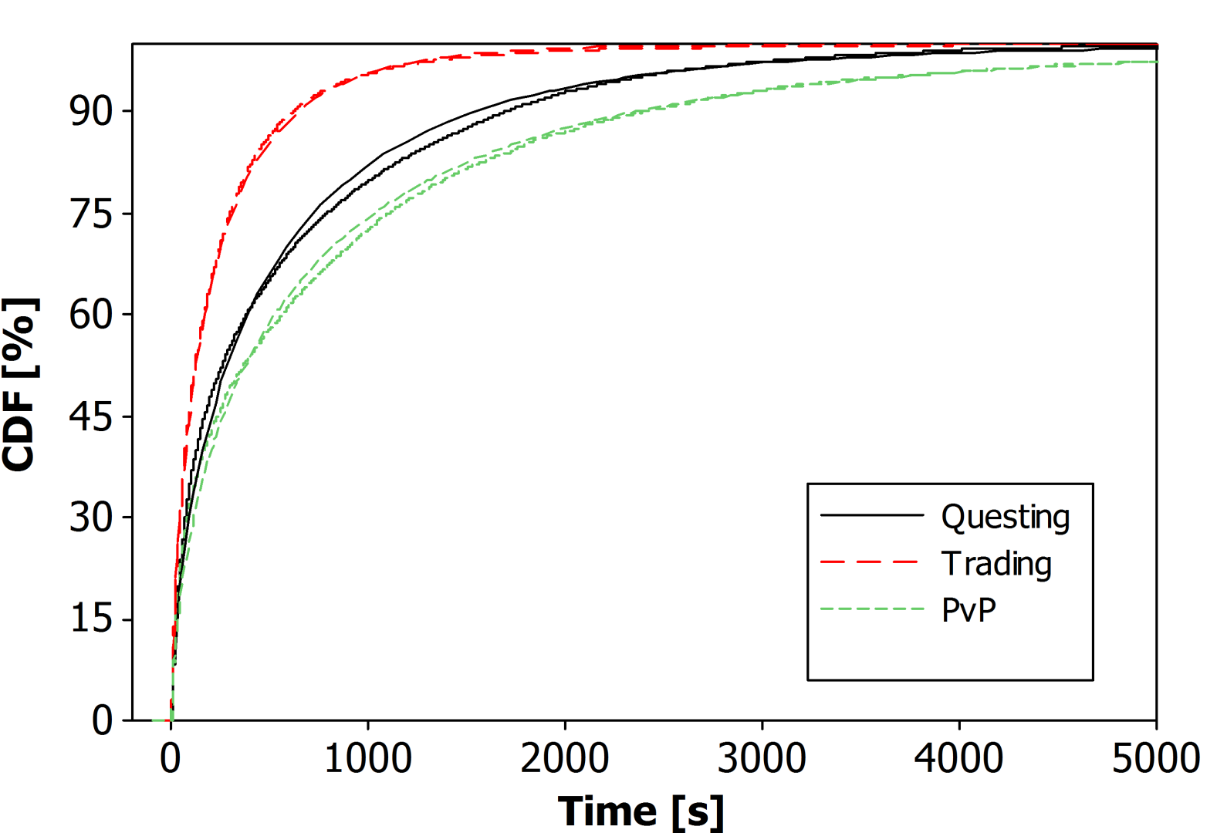
Results – Segment duration goodness of fit
Questing, Trading, and PvP combat
Notes:
I find them quite resonable… Here are the Empricial CDFs of questing trading and PvP combt with their respective fits.

Slide 22
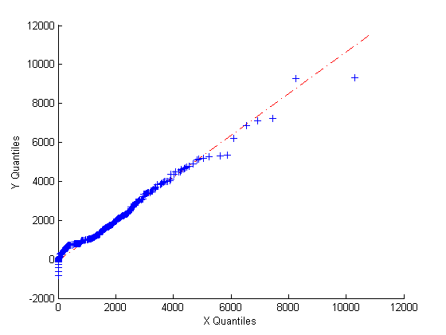
Results – Segment duration goodness of fit
Dungeons
Notes:
To change grapsh a bit here is a QQ plot of Dungeos.

Slide 23
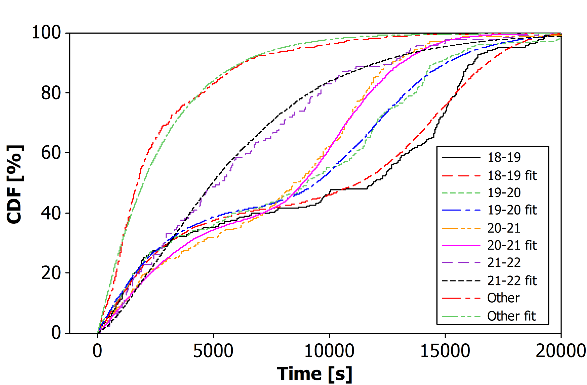
Results – Segment duration goodness of fit
Raiding
Notes:
And in the end empirical CDFs and their fits for different hours of Raidings.
I think you will agree with me that most of the fits are reasonable.
That was modeling process for the duration of the session segments now lets see how we shall model their probabilities.

Slide 24
Results – Segment probability
Trading
Questing
PvP combat
Raiding
Dungeons
Notes:
As we cann see probabilites vary during the day may single player activity (Questing) is mostly popular in the morning but towards the evning it drops, while group based activities such as raiding and dungeons grow.
Trading and PvP combat are more or less same throught the day.

Slide 25
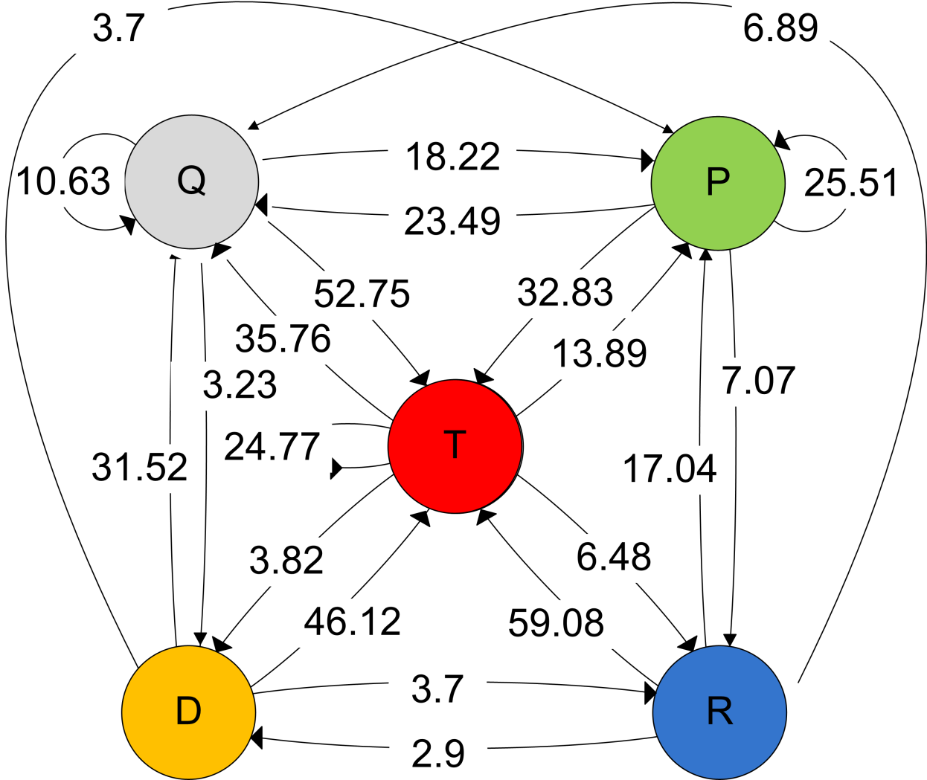
Results – Segment probability models
1st order Markov chain for each hour of the day
Notes:
So what we did, we created a first order markov chains for each hour. Here the starting state is not drawn in order to simplify the diagram. As well as probabilities below 2%. So if a player was questing there is a chance of 18.22 percent that the next segment will be PvP combat or 52% chance that the next segment will be trading.
So incorporating all these math into a prorgram gives

Slide 26
Implementation
Player behavior simulator
Service independent
Input
XML files containing full service definition
Output
Dynamic graph
Concurrent notification of all newly created session segment
3 log files describing the simulation
Notes:
Our Player Behavior Simulator which is created so it is service independent, meaning that all input data is stored in an INPUT XML service definition. So you can easily add other services to it.
Output of the simulator is a dynamic graph describing the simulation, concurent output of all newly created sessions segments and tree log files describing the simulation

Slide 27
Implementation - GUI
Notes:
So this is the GUI, in this meny we controll wheter to simulate one day or the whole week, then there is a simulation speed bar whichh can speed the simulation up to 1500 times, Dynamic graph presenting the number of players in each category, contorling mechanism, and in the end we have this part which we aimed to do, controll of a traffic generating process form our simulator.

Slide 28
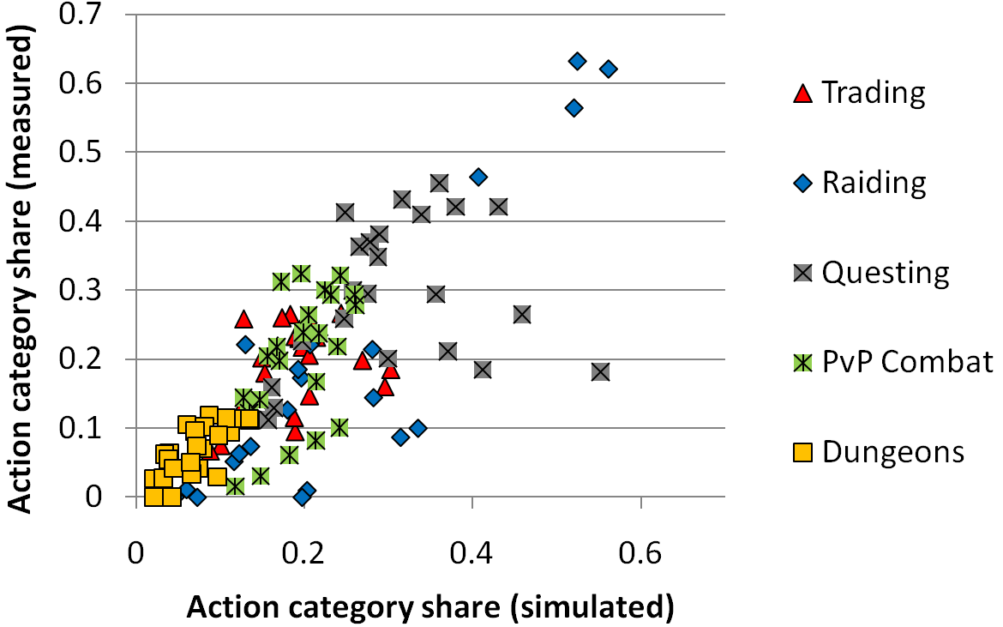
Implementation - Testing
Notes:
How does the simulator perform in respect to theoretical data, here we see that share of time spent playing particular action categories across hours of the day in the simulated data vs the measured data.
We can see that the results lie in a diagonal while there is some dicrepancies as this is all a random process. To conclude-…

Slide 29
Conclusion
We investigated player behavior in MMORPGs in order to better understand, predict and simulate load on the MMORPG system
We created player behavior model
Session length
Player number
Session composition
Model implemented in Player behavior simulator
Results enable
Better infrastructure planning and optimization
Churn analysis
Input for other tools
Future work – behavior aware traffic generator
Notes:
What, we set out to create a player behavior model in an effort to better understand how player behavior affects the load of MMORPG system. Particular problem addressed in this paper was creation of a player behavior model capturing session length, player number and session composition.
Other result of this work is an implementation of the model in our Player Behavior Simulator.
The results can be used for better planning of MMORPG system of both server and network, and also better adapting to changes in the game. Also it can be used for churn analysis detection of digital theft and soon. We think that our simulator can be a good source of information for other tools such as load balancing algorithms, or a traffic generator which is our next move. A traffic generator aware of player behavior. Hopefully our research effort will result in some more slain dragons ☺

Slide 30
